Slide 1
Parts Options
Group 1

Slide 2
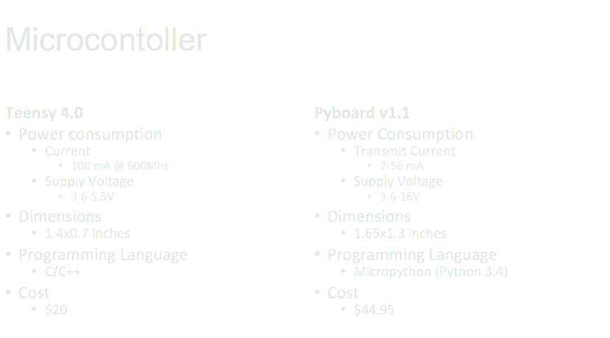
Previous Selection: Arduino Uno
Extras:
1 LED
1 Buttons
Extras:
4 LEDs
2 Buttons

Slide 3
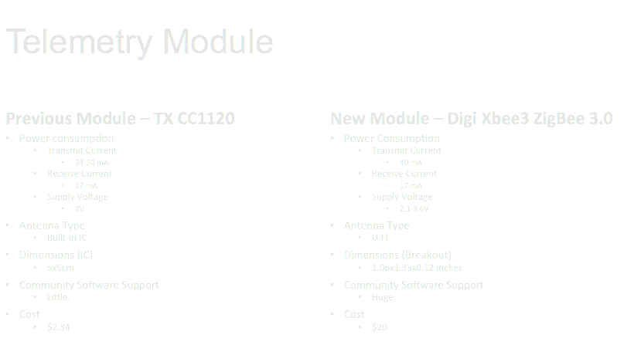

Slide 4
GPS Module (Adafruit Ultimate GPS Module)
Sensitivity
~ 3 meters
Power Consumption
Voltage
3-5.5V
Current
20 mA during navigation
Dimensions
Breakout: 1.0" x 1.35" x 0.25"
IC: 0.63” x 0.63”
Cost
$30-40

Slide 5

Software for Telemetry

Slide 6
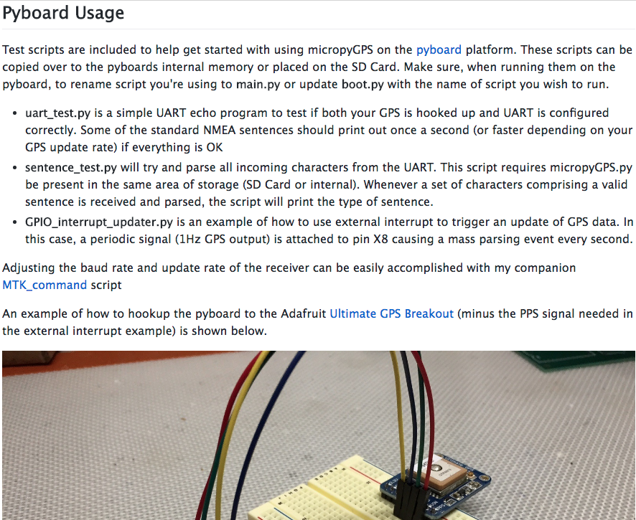
Software for GPS

Slide 7
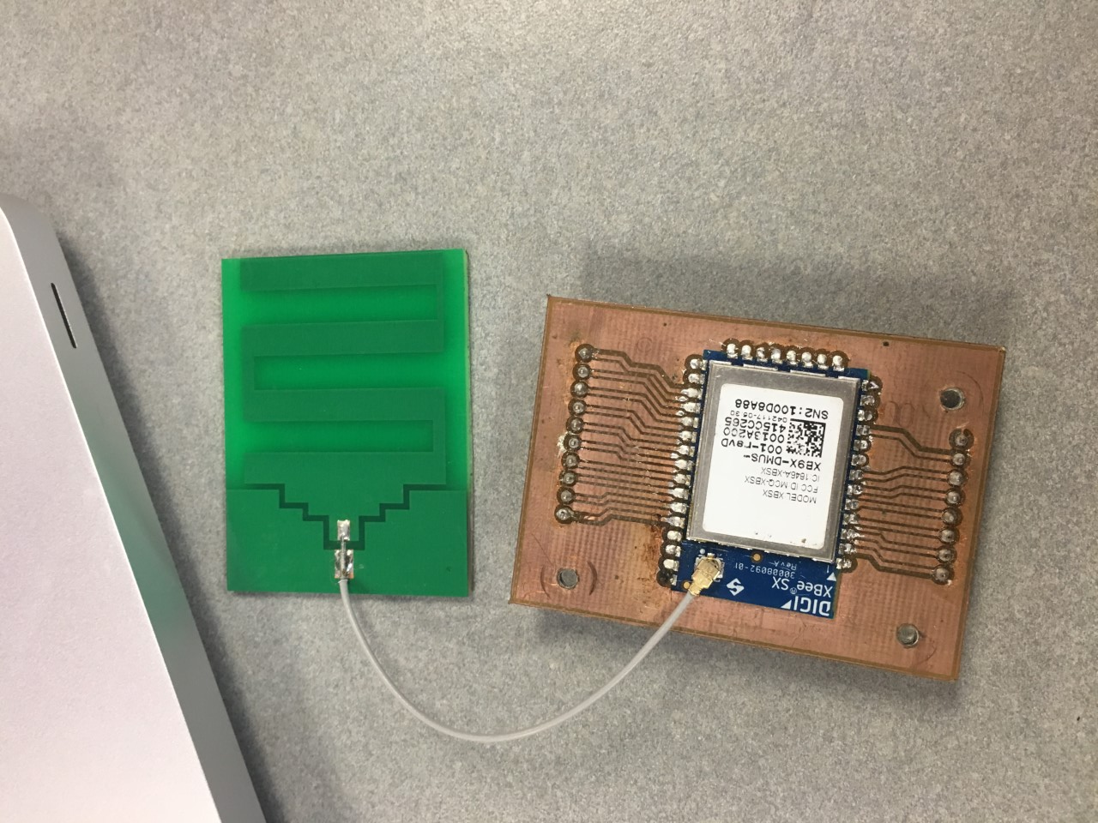
Antenna - U. Fl

Slide 8
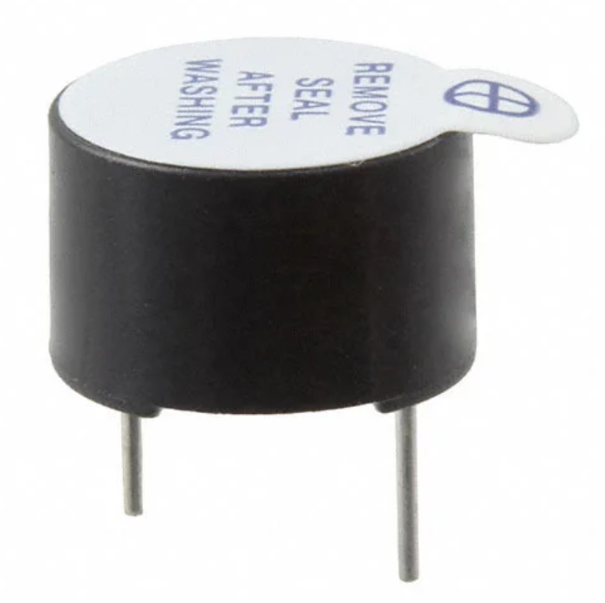
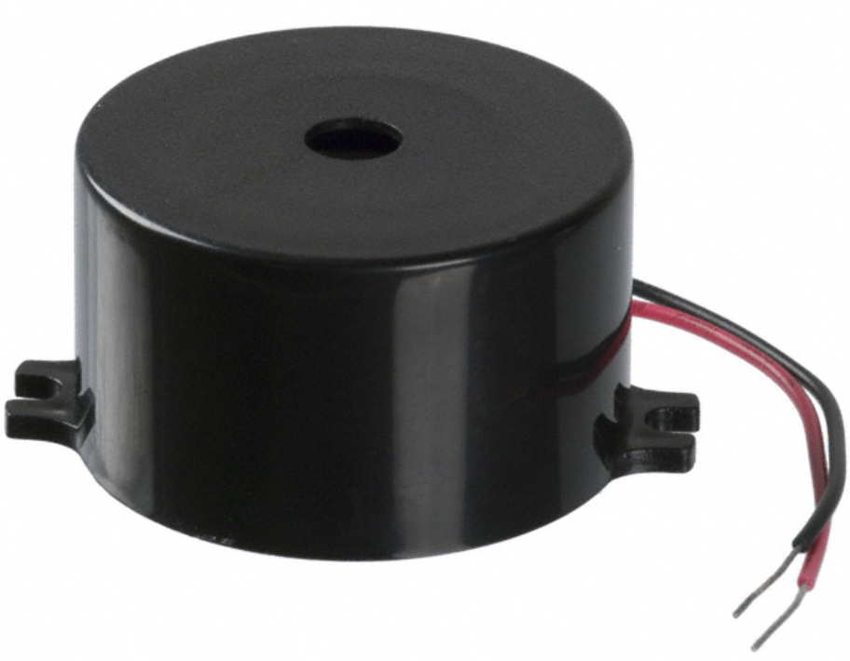
Buzzer Options
PUI Audio Inc. AI-1223-TWT-3V-2-R
2-4VDC Operating
30mA max
Through Hole PCB mount
12mm diameter, 8mm height
82 dBA @ 10cm
$1.33 on DigiKey
PUI Audio Inc. X-4033-TF-LW80-R
Highest dBA below @ voltage below 12 VDC
1.5-12 VDC Operating
9mA max
Wire Leads, panel mount flange
50mm diameter, 23mm height
106 dBA @ 10cm
$7.43 on DigiKey

Slide 9
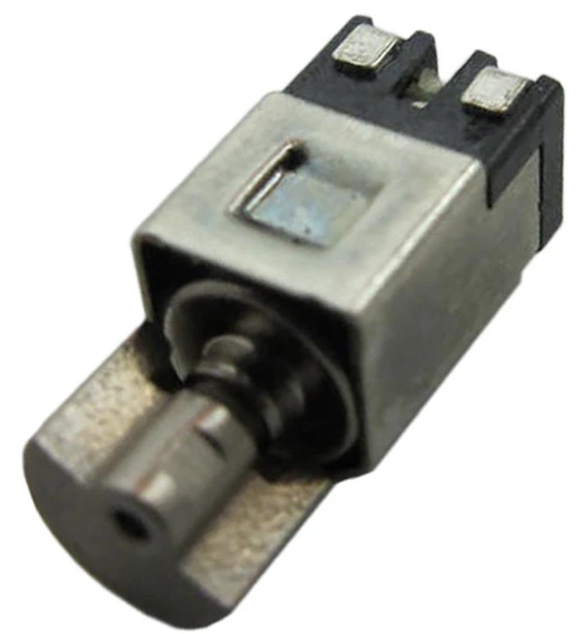
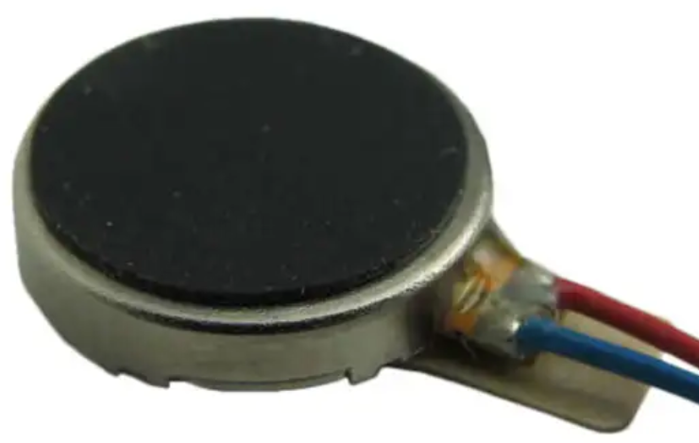
Vibrator Options
Cylinder with Half-Moon Rotator
Solder on, lead wire options
3VDC operation
Check Operating Voltage level (2.7~3.3)
4.5x4.85x10.9 mm
$2.70-$4.50
How to mount? Harness?
Coin Vibrator Motor
Solder tab, lead wire options
3 VDC operation
Check Operating Voltage level (2.7~3.3)
9mm diameter, 2.25mm height
$1.22-$4.50
How to mount? Glue?

Slide 10
Battery
Using microcontroller ADC to measure battery charge
Battery options:
Lithium rechargeable battery
Store bought coin battery
Size will be based on power needed by other major components

Slide 11
Concerns to bring up at sponsor meeting
Choose between battery life and physical size
Not going to meet dB constraint
Revisit using GPS with sponsor

